Slide 1

Sentiment analysis of Wine-reviews
Big Data Analysis

Slide 2

Problem statement
Common criteria/benchmark when buying items?
Increase industrial profit and sales strategy
_{(recommendations).}
Sentiment analysis for better regional and
_{international trends.}
Understanding clients emotions and expectations can be key to keeping customers.

Slide 3
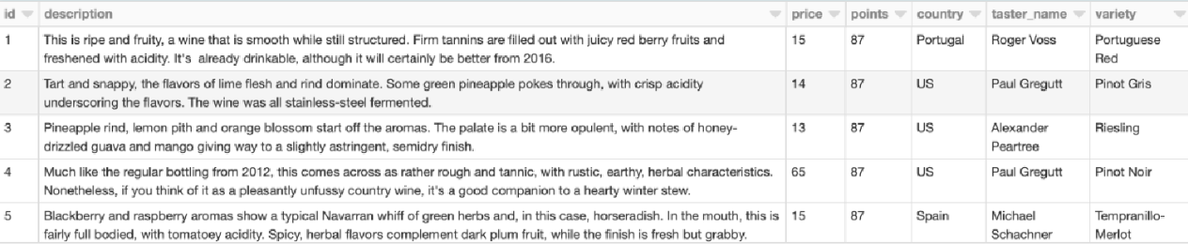
Dataset description
Data-set source: https://www.kaggle.com/datasets/zynicide/wine-reviews
Supervised learning
Why this?
130K instances with 14 attributes each
Hybrid data
File type: “.csv”

Slide 4
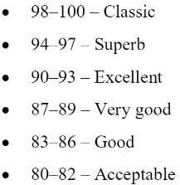
Objective
Predicting ratings of wines from information/feedback from customers.
Perform Natural language processing, sentiment analysis and tune ML models for better results. (Word2Vec, TF-IDF)
Regression and classification.
Scoring scale
Use Apache PySpark and
HDFS for this
Big data analysis

Slide 5






Tools

Slide 6
Thank You
KV Varun
S20190020222

